Slide 1


Fourier Representations of Signals & LTI Systems
3.1 Introduction
1. A signal can be represented as a weighted superposition of complex
sinusoids.
x(t) or x[n]
y(t) or y[n]
2. LTI system:
LTI System
Output = A weighted superposition of the system response to each complex sinusoid.
3. Four distinct Fourier representations
3.2 Complex Sinusoids and Frequency Response of LTI
Systems
♣ Frequency response ≡ The response of an LTI system to a sinusoidal input.
♣ Discrete-time LTI system
1. Impulse response of discrete-time LTI system = h[n], input = x[n] = e ^{j Ωn}
2. Output:
$$e^{jωt}=\cos\left(ωt\right)+j sin⁡(ωt)$$
$$e^{jΩn}=\cos\left(Ωn\right)+j sin⁡(Ωn)$$

Slide 2


Fourier Representations of Signals & LTI Systems
Figure 3.1
The output of a complex sinusoidal input to an LTI system is a complex sinusoid of the same frequency as the input, multiplied by the frequency response of the system.
3. Frequency response:
Complex scaling factor
k
A function of frequency Ω
♣ Continuous-time LTI system
$$e^{jωt}=\cos\left(ωt\right)+j sin⁡(ωt)$$
1. Impulse response of continuous-time LTI system = h(t), input = x(t) = e ^{j ω t}
2. Output:

Slide 3
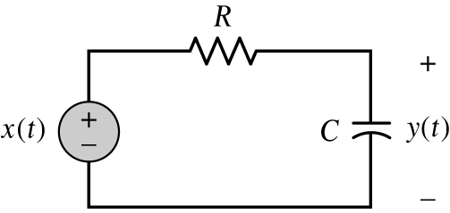
Fourier Representations of Signals & LTI Systems
3. Frequency response:
Example 3.1 RC Circuit: Frequency response
The impulse response of the system relating to the input voltage to the voltage across the capacitor in Fig
Find an expression for the frequency response

Slide 4
Fourier Representations of Signals & LTI Systems
<Sol.>
Frequency response:

Slide 5
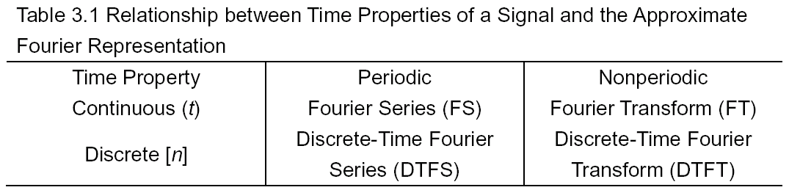
Fourier Representations of Signals & LTI Systems
3.3 Fourier Representations for Four classes of Signals
♦ Four distinct Fourier representations:

Slide 6
Fourier Representations of Signals & LTI Systems
3.3.1 Periodic Signals: Fourier Series Representations
1. x[n] = discrete-time signal with fundamental period N. DTFS of x[n] is
Ω_{o} = 2π/N ≡ Fundamental frequency of x[n]
2. x(t) = continuous-time signal with fundamental period T. FS of x(t) is
ω_{o} = 2π/T ≡ Fundamental frequency of x(t)
♣ A[k] = the weight applied to the k^{th} harmonic.
3. The complex sinusoids exp(jkΩ_{o}n) are N-periodics in the frequency index k.
<pf.>
There are only N distinct complex sinusoids of the form exp(jkΩ₀n) should be used in Eq. (3.4).
♣ If x[n] is symmetric in odd or even, we can choose k as:
k = − (N − 1)/2 to (N − 1)/2

Slide 7
Fourier Representations of Signals & LTI Systems
4. Continuous-time complex sinusoid exp(jkω₀t) with distinct frequencies kω₀
are always distinct.
FS of continuous-time periodic signal x(t) becomes
♣ Mean-square error (MSE) between the signal and its series representation:
Discrete-time case:
Continuous-time case:
3.3.2 Nonperiodic Signals: Fourier-Transform Representations
1. FT of continuous-time signal:
X(jω)/(2π) = the weight applied to a sinusoid of frequency ω in the FT representation.

Slide 8
2. DTFT of discrete-time signal:
X(e ^{j Ω})/(2π) = the weight applied to the sinusoid e^{j Ωn} in the DTFT representation.

Slide 9
Fourier Representations of Signals & LTI Systems
3.4 Discrete-Time Periodic Signals: The Discrete-Time
Fourier Series
1. DTFS pair of periodic signal x[n]:
Fundamental period = N; Fundamental frequency = Ω_{o} = 2π/N
Fourier coefficients; Frequency domain representation
♣ Notation:
Example Determining DTFS Coefficients
Find the frequency domain representation of the signal depicted in Fig.
<Sol.>
1. Period: N = 5
Ω_{o} = 2π/5

Slide 10
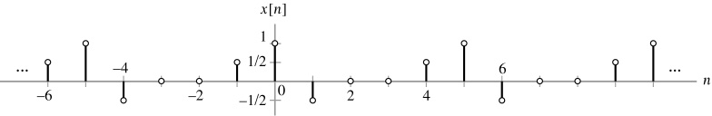

Slide 11
Fourier Representations of Signals & LTI Systems
Figure 3.5
Time-domain signal for Example.
2. Odd symmetry
n = − 2 to n = 2
3. Fourier coefficient:

Slide 12
Fourier Representations of Signals & LTI Systems
♣ One period of the DTFS coefficients X[k], k = − 2 to k = 2:
3. Calculate X[k] using n = 0 to n = 4:

Slide 13
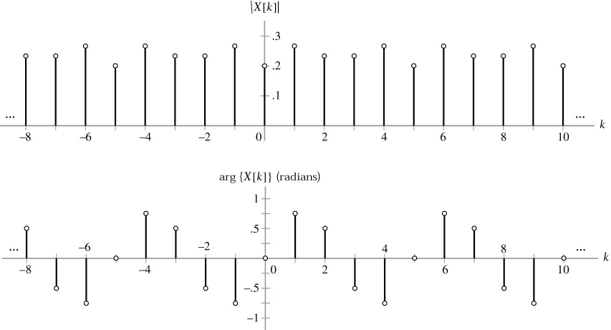
Fourier Representations of Signals & LTI Systems
Even function
Odd function
Figure 3.6
Magnitude and phase of the DTFS coefficients for the signal in Fig. 3.5.

Slide 14
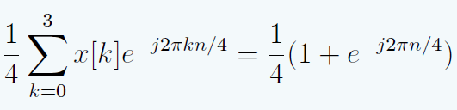
X[k]={1,1,0,0}
X[k]={1/2, ¼ (1-j), 0, ¼ (1+j)}

Slide 15
Quiz

Slide 16
DTFS

Slide 18
Example Computation of DTFS by Inspection

Slide 19
Fourier Representations of Signals & LTI Systems
Example 3.3 Computation of DTFS by Inspection
Determine the DTFS coefficients of x[n] = cos (nπ/3 + φ), using the method of inspection.
<Sol.>
1. Period: N = 6
Ω_{o} = 2π/6 = π/3
2. Using Euler’s formula, x[n] can be expressed as
3. Compare Eq. with the DTFS of Eq. with Ω_{o} = π/3, written by
summing from k = − 2 to k = 3:
Equating terms in Eqs equal frequencies, kπ/3, gives

Slide 20
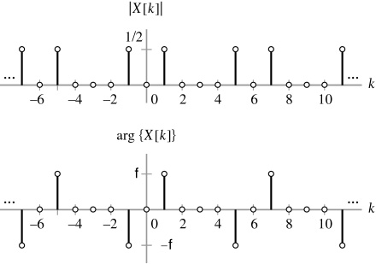
Fourier Representations of Signals & LTI Systems
4. Magnitude spectrum and phase spectrum of X[k]: Fig. 3.8.
Figure 3.8
Magnitude and phase of DTFS coefficients
φ
− φ

Slide 21
Q

Slide 22
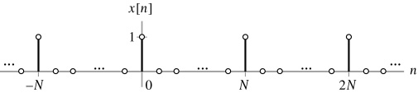
Fourier Representations of Signals & LTI Systems
Example 3.4 DTFS Representation of An Impulse Train
Find the DTFS coefficients of the N-periodic impulse train
as shown in Fig. 3.9.
<Sol.>
It is convenient to evaluate Eq. over the interval n = 0 to n = N − 1 to obtain
Figure 3.9
A discrete-time impulse train with period N.

Slide 23
Fourier Representations of Signals & LTI Systems
Example 3.5 The Inverse DTFS
Use Eq. (3.10) to determine the time-domain signal x[n] from the DTFS coefficients depicted in Fig. 3.10.

Slide 24
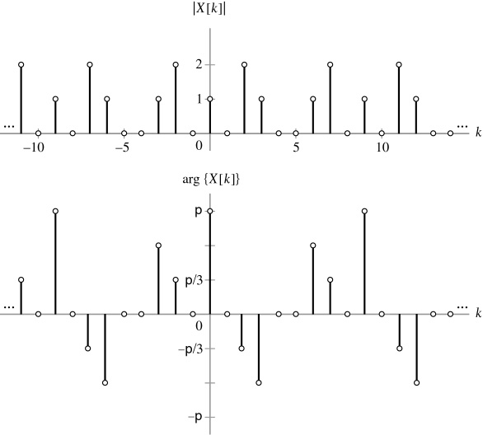
Fourier Representations of Signals & LTI Systems
π
π/3
Figure 3.10
Magnitude and phase of DTFS coefficients for Example 3.5.
− π/3
− π

Slide 25
<Sol.>
1. Period of DTFS coefficients = 9
Ω_{o} = 2π/9
2. It is convenient to evaluate Eq.(3.11) over the interval k = − 4 to k = 4 to obtain
π
π/3

Slide 26
Fourier Representations of Signals & LTI Systems
3.5 Continuous-Time Periodic Signals: The Fourier Series
♦ Fourier series pair ⎯ Exponential FS
1. Continuous-time periodic signals are represented by the Fourier series (FS).
2. A signal with fundamental period T and fundamental frequency ω_{o} = 2π/T,
the FS pair of x(t) is
Frequency domain representation of x(t)
3. Notation:
♦ Mean-square error (MSE)
1. Suppose we define
and choose the coefficients X[k] according to Eq.(3.20.)

Slide 27
Fourier Representations of Signals & LTI Systems
2. If x(t) is square integrable,
then the MSE between x(t) and
is zero, or, mathematically,
at all values of t; it simply implies that there is zero power
in their difference.
3. Pointwise convergence of
is guaranteed at all values of t
except those corresponding to discontinuities if the Dirichlet conditions are satisfied:
x(t) is bounded.
x(t) has a finite number of maximum and minima in one period.
♦ x(t) has a finite number of discontinuities in one period.

Slide 28
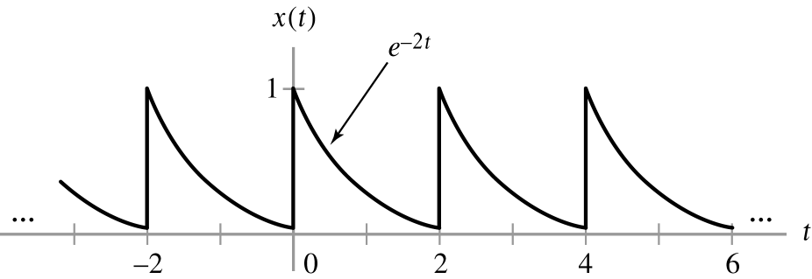

Slide 29
Fourier Representations of Signals & LTI Systems
Example 3.9 Direct Calculation of FS Coefficients
Determine the FS coefficients for the signal x(t) depicted in Fig. 3.16.
<Sol.>
1. The period of x(t) is T = 2,
so ω_{o} = 2π/2 = π.
2. One period of x(t): x(t) = e ^{− 2t},
0 ≤ t ≤ 2.
3. FS of x(t):
Figure 3.16
Time-domain signal for Example 3.9.
Fig. 3.17.
e ^{− jk2π} = 1
♣ The Magnitude of X[k] ≡ the magnitude spectrum of x(t);
the phase of X[k] ≡ the phase spectrum of x(t).

Slide 30
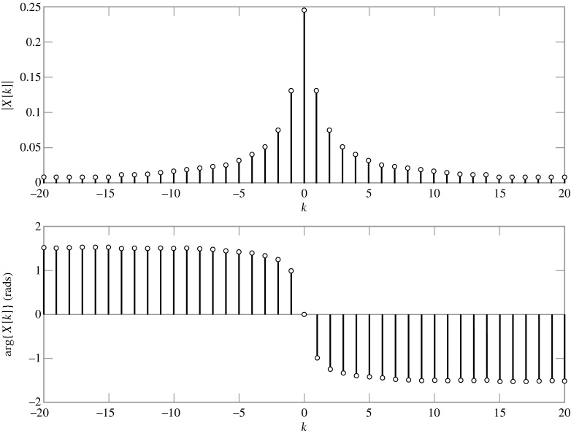
Fourier Representations of Signals & LTI Systems
Figure 3.17
Magnitude and phase spectra for Example 3.9.

Slide 32
Fourier Representations of Signals & LTI Systems
Example 3.10 FS Coefficients for An Impulse Train
Determine the FS coefficients for the signal x(t) defined by
<Sol.>
1. Fundamental period of x(t) is T = 4, each period contains an impulse.
2. By integrating over a period that is symmetric about the origin − 2 < t ≤ 2, to
obtain X[k]:
3. The magnitude spectrum is constant and the phase spectrum is zero.

Slide 34
Fourier Representations of Signals & LTI Systems
Example 3.11 Calculation of FS Coefficients By Inspection
Determine the FS representation of the signal
<Sol.>
1. Fundamental period of x(t) is T = 4, and ω_{o} = 2π/4 = π/2. Eq. (3.19) is written
as
(3.21)
2. Equating each term in this expression to the terms in Eq. (3.21) gives the FS
coefficients:
Magnitude and phase spectrum: Fig. 3.18.
(3.22)

Slide 35
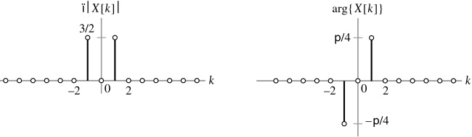
π/4
− π/4
Figure 3.18
Magnitude and phase spectra for Example 3.11.

Slide 36
FS for A Square Wave

Slide 37
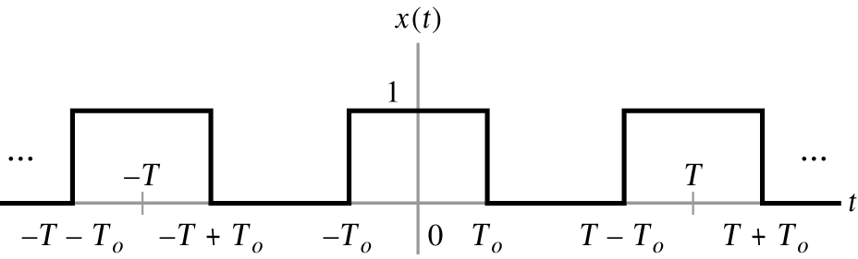
Fourier Representations of Signals & LTI Systems
Example 3.13 FS for A Square Wave
Determine the FS representation of the square wave depicted in Fig. 3.21.

Slide 38
Fourier Representations of Signals & LTI Systems
1. Fundamental frequency: ω_{o} = 2π/T.
2. X[k]: by integrating over − T/2 ≤ t ≤ T/2
For k = 0, we have
3. By means of L’Hôpital’s rule, we have

Slide 39
Fourier Representations of Signals & LTI Systems

Slide 40
Quiz

Slide 41
Fourier Representations of Signals & LTI Systems
♣ Time-domain representation obtained from FS coefficients
Example 3.12 Inverse FS
Find the time-domain signal x(t) corresponding to the FS coefficients
Assume that the fundamental period is T = 2.
<Sol.>
1. Fundamental frequency: ω_{o} = 2π/T = π. From Eq. (3.19), we obtain
2. Putting the fraction over a common denominator results in

Slide 44
Fourier Representations of Signals & LTI Systems
3.6 Discrete-Time Nonperiodic Signals: The Discrete-Time
Fourier Transform (DTFT)
1. The DTFT is used to represent a discrete-time nonperiodic signal as a
superposition of complex sinusoids.
2. DTFT representation of time-domain signal x[n]:
DTFT pair
(3.31)
(3.32)
Frequency-domain representation x[n]
3. Notation:
4. Condition for convergence of DTFT:
If x[n] is of infinite duration, then the sum converges only for certain classes of signals. If x[n] is absolutely summable, i.e.,
The sum in Eq. (3.32) converges uniformly to a continuous function of Ω.

Slide 45
Fourier Representations of Signals & LTI Systems
♣ If x[n] is not absolutely summable, but does satisfy (i.e., if x[n] has finite
energy),
It can be shown that the sum in Eq. (3.32) converges in a mean-square error sense, but does not converge pointwise.
Example 3.17 DTFT of An Exponential Sequence
Find the DTFT of the sequence x[n] = α^{n}u[n].
<Sol.>
1. DTFT of x[n]:
This sum diverges for
2. For α < 1, we have

Slide 46
Fourier Representations of Signals & LTI Systems
4. Magnitude and phase spectra:
Even function
Odd function
Fig. 3.29 for α = 0.5 and α = 0.9.

Slide 49
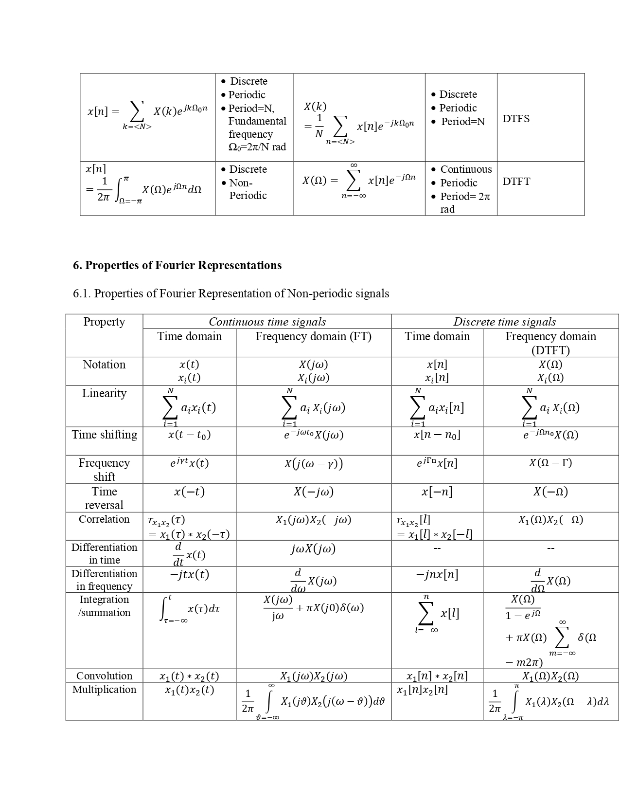
Properties

Slide 56
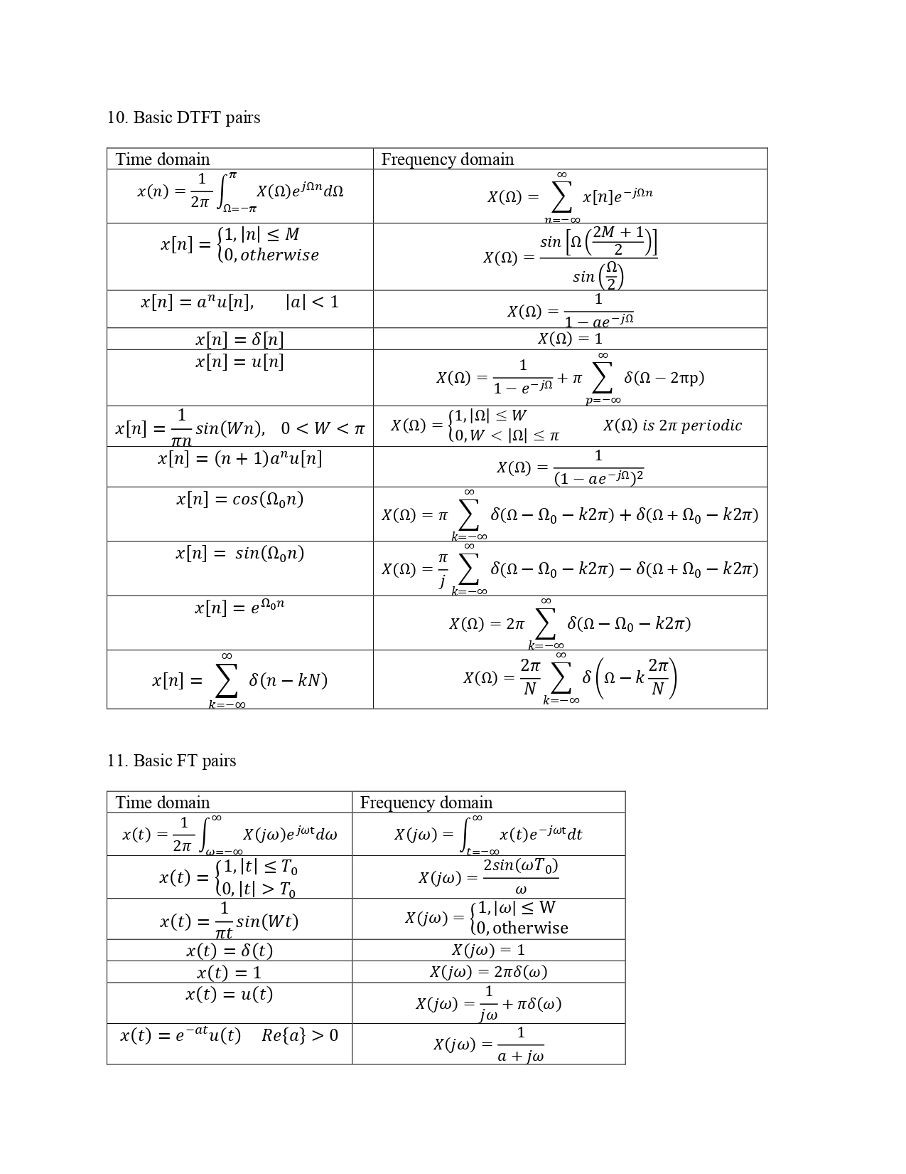

Slide 59
FT pairs

Slide 60

Fourier Representations of Signals & LTI Systems
3.7 Continuous-Time Nonperiodic Signals: The Fourier
Transform (FT)
1. The Fourier transform (FT) is used to represent a continuous-time non-
periodic signal as a superposition of complex sinusoids.
2. FT representation of time-domain signal x(t):
(3.35)
Frequency-domain representation of the signal x(t)
(3.36)
3. Notation for FT pair:
4. Convergence condition for FT:
1) Approximation:
2) Squared error between x(t) and : the error energy, given by

Slide 61
Fourier Representations of Signals & LTI Systems
is zero if x(t) is square integrable, i.e., if
♣ Zero squared error does not imply pointwise convergence [i.e., ]
at all values of t.
There is zero energy in the difference of
3. Pointwise convergence of
is guaranteed at all values of t
except those corresponding to discontinuities if x(t) satisfies the Dirichlet conditions for nonperiodic signals:
♦ x(t) is absolutely integrable:
♦ x(t) has a finite number of maximum, minima, and discontinuities in any
finite interval.
♦ The size of each discontinuity is finite.

Slide 64
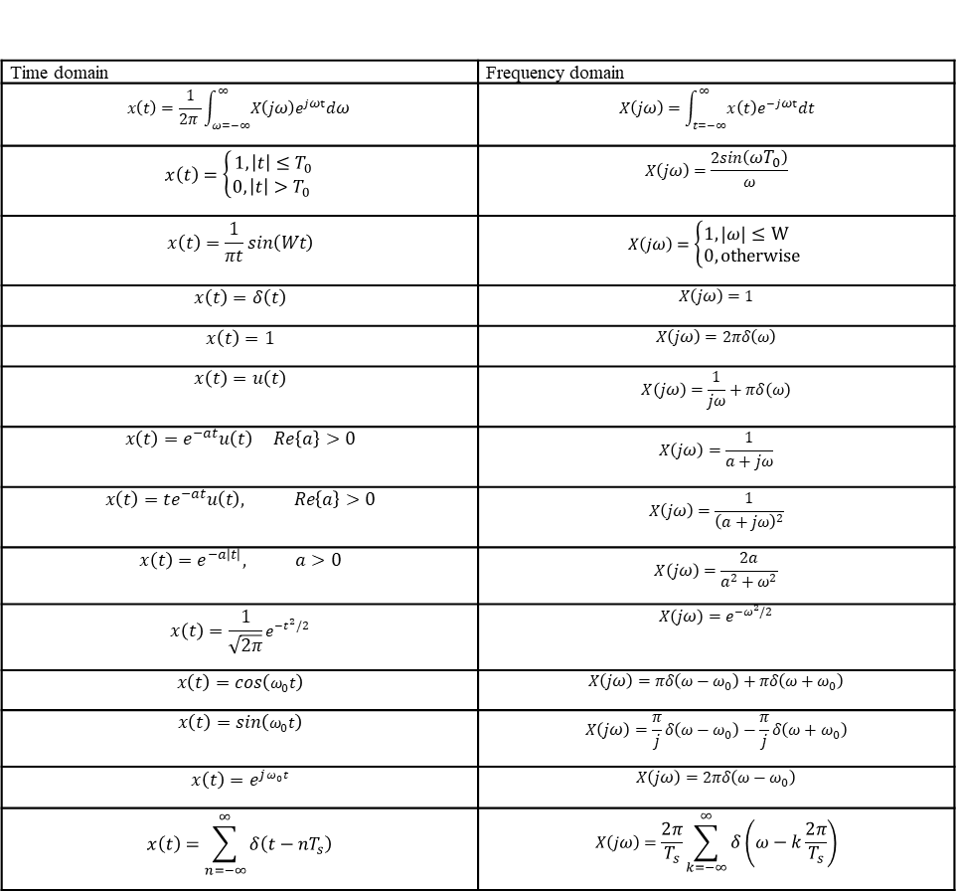
Important FT
Time domain | Frequency domain
$$x\left(t\right)=\frac{1}{2π }\int_{ω=−∞}^{∞}{X\left(jω\right)e^{jωt}dω}$$ | $$X\left(jω\right)=\int_{t=−∞}^{∞}{x\left(t\right)e^{−jωt}dt}$$
$$x\left(t\right)=\left\{\begin{aligned}1, \left|t\right|≤T_{0} \\ 0, \left|t\right|>T_{0} \end{aligned}\right.$$ | $$X\left(jω\right)=\frac{2sin\left(ωT_{0}\right)}{ω}$$
$$x\left(t\right)=\frac{1}{πt}sin\left(Wt\right)$$ | $$X\left(jω\right)=\left\{\begin{aligned}1, \left|ω\right|≤W \\ 0, otherwise \end{aligned}\right.$$
$$x\left(t\right)=δ\left(t\right)$$ | $$X\left(jω\right)=1$$
$$x\left(t\right)=1$$ | $$X\left(jω\right)=2πδ\left(ω\right)$$
$$x\left(t\right)=u\left(t\right)$$ | $$X\left(jω\right)=\frac{1}{jω}+πδ\left(ω\right)$$
$$x\left(t\right)=e^{−at}u\left(t\right) Re\left\{a\right\}>0$$ | $$X\left(jω\right)=\frac{1}{a+jω}$$
$$x\left(t\right)={te}^{−at}u\left(t\right), Re\left\{a\right\}>0$$ | $$X\left(jω\right)=\frac{1}{{\left(a+jω\right)}^{2}}$$
$$x\left(t\right)=e^{−a\left|t\right|}, a>0$$ | $$X\left(jω\right)=\frac{2a}{a^{2}+ω^{2}}$$
$$x\left(t\right)=\frac{1}{\sqrt{2π}}e^{−t^{2}/2}$$ | $$X\left(jω\right)=e^{−ω^{2}/2}$$
$$x\left(t\right)=cos\left(ω_{0}t\right)$$ | $$X\left(jω\right)=πδ\left(ω−ω_{0}\right)+πδ\left(ω+ω_{0}\right)$$
$$x\left(t\right)=sin\left(ω_{0}t\right)$$ | $$X\left(jω\right)=\frac{π}{j}δ\left(ω−ω_{0}\right)−\frac{π}{j}δ\left(ω+ω_{0}\right)$$
$$x\left(t\right)=e^{jω_{0}t}$$ | $$X\left(jω\right)=2πδ\left(ω−ω_{0}\right)$$
$$x\left(t\right)=\sum_{n=−∞}^{∞}{δ\left(t−nT_{s}\right)}$$ | $$X\left(jω\right)=\frac{2π}{T_{s}}\sum_{k=−∞}^{∞}{δ\left(ω−k\frac{2π}{T_{s}}\right)}$$

Slide 65
Properties

Slide 68
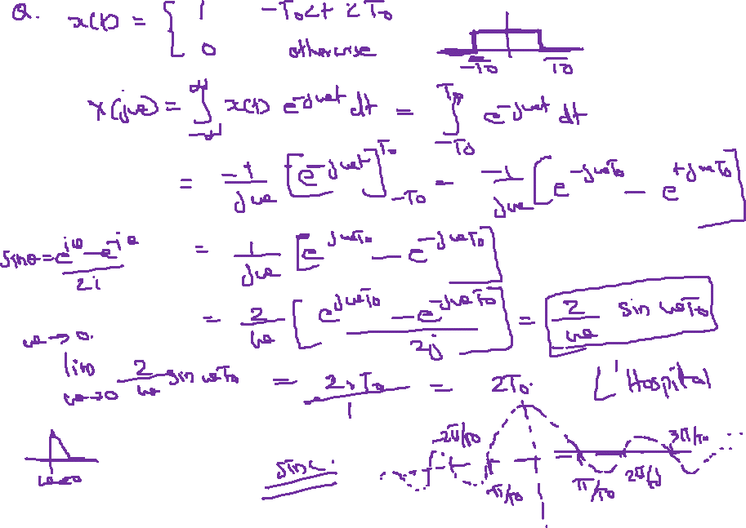

Slide 69
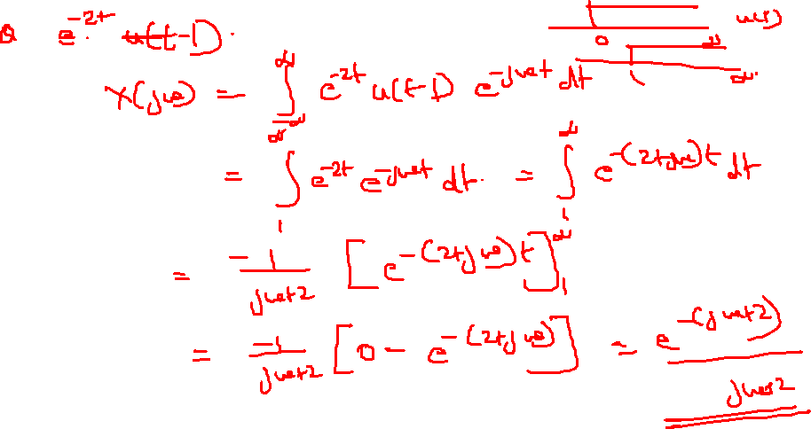

Slide 70
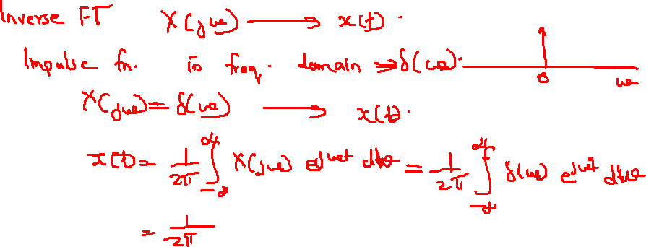

Slide 71
Important FT
Time domain | Frequency domain
$$x\left(t\right)=\frac{1}{2π }\int_{ω=−∞}^{∞}{X\left(jω\right)e^{jωt}dω}$$ | $$X\left(jω\right)=\int_{t=−∞}^{∞}{x\left(t\right)e^{−jωt}dt}$$
$$x\left(t\right)=\left\{\begin{aligned}1, \left|t\right|≤T_{0} \\ 0, \left|t\right|>T_{0} \end{aligned}\right.$$ | $$X\left(jω\right)=\frac{2sin\left(ωT_{0}\right)}{ω}$$
$$x\left(t\right)=\frac{1}{πt}sin\left(Wt\right)$$ | $$X\left(jω\right)=\left\{\begin{aligned}1, \left|ω\right|≤W \\ 0, otherwise \end{aligned}\right.$$
$$x\left(t\right)=δ\left(t\right)$$ | $$X\left(jω\right)=1$$
$$x\left(t\right)=1$$ | $$X\left(jω\right)=2πδ\left(ω\right)$$
$$x\left(t\right)=u\left(t\right)$$ | $$X\left(jω\right)=\frac{1}{jω}+πδ\left(ω\right)$$
$$x\left(t\right)=e^{−at}u\left(t\right) Re\left\{a\right\}>0$$ | $$X\left(jω\right)=\frac{1}{a+jω}$$
$$x\left(t\right)={te}^{−at}u\left(t\right), Re\left\{a\right\}>0$$ | $$X\left(jω\right)=\frac{1}{{\left(a+jω\right)}^{2}}$$
$$x\left(t\right)=e^{−a\left|t\right|}, a>0$$ | $$X\left(jω\right)=\frac{2a}{a^{2}+ω^{2}}$$
$$x\left(t\right)=\frac{1}{\sqrt{2π}}e^{−t^{2}/2}$$ | $$X\left(jω\right)=e^{−ω^{2}/2}$$
$$x\left(t\right)=cos\left(ω_{0}t\right)$$ | $$X\left(jω\right)=πδ\left(ω−ω_{0}\right)+πδ\left(ω+ω_{0}\right)$$
$$x\left(t\right)=sin\left(ω_{0}t\right)$$ | $$X\left(jω\right)=\frac{π}{j}δ\left(ω−ω_{0}\right)−\frac{π}{j}δ\left(ω+ω_{0}\right)$$
$$x\left(t\right)=e^{jω_{0}t}$$ | $$X\left(jω\right)=2πδ\left(ω−ω_{0}\right)$$
$$x\left(t\right)=\sum_{n=−∞}^{∞}{δ\left(t−nT_{s}\right)}$$ | $$X\left(jω\right)=\frac{2π}{T_{s}}\sum_{k=−∞}^{∞}{δ\left(ω−k\frac{2π}{T_{s}}\right)}$$

Slide 72
Properties

Slide 75

Fourier Representations of Signals & LTI Systems
CHAPTER
3
Example 3.24 FT of A Real Decaying Exponential
Find the FT of x(t) = e ^{− a t} u(t), shown in Fig. 3.39(a).
<Sol.>
1. For a ≤ 0, since x(t) is not absolutely integrable, i.e.,
The FT of x(t) does not converge for a ≤ 0.
2. For a > 0, the FT of x(t) is
3. Magnitude and phase of X(jω):
Fig. 3.39 (b) and (c).

Slide 76
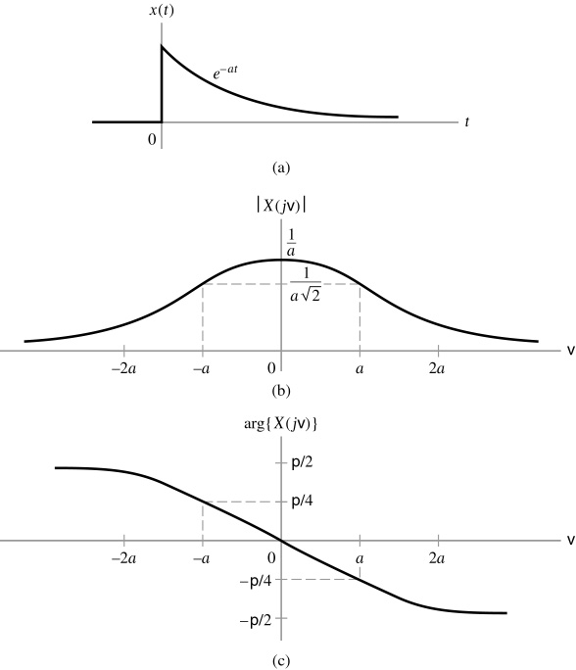
Fourier Representations of Signals & LTI Systems
CHAPTER
3
Figure 3.39 (p. 243)
Example 3.24. (a) Real time-domain exponential signal.
(b) Magnitude spectrum.
(c) Phase spectrum.
⏐X(jω) ⏐
ω
arg{X(jω)}
π/4
π/4
ω
− π/4
− π/2

Slide 77
Fourier Representations of Signals & LTI Systems
CHAPTER
3
Example 3.25 FT of A Rectangular Pulse
Consider the rectangular pulse depicted in Fig. 3.40 (a) and defined as
Find the FT of x(t).
<Sol.>
1. The rectangular pulse x(t) is absolutely integrable, provided that T_{o} < ∞.
2. FT of x(t):
With understanding that the value at ω = 0 is obtained by evaluating a limit.
3. For ω = 0, the integral simplifies to 2T_{o}.
4. Magnitude spectrum:

Slide 78
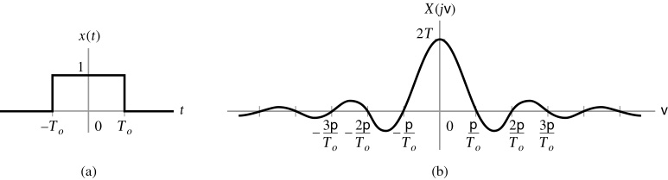
Fourier Representations of Signals & LTI Systems
CHAPTER
3
Fig. 3. 40 (b).
5. Phase spectrum:
6. X(jω) in terms of sinc function:
As T_{o} increases, the nonzero time extent of x(t) increases, while X(jω) becomes more concentrated about the frequency origin.
v ≡ ω; p ≡ π
Figure 3.40 (p. 244)
Example 3.25. (a) Rectangular pulse in the time domain. (b) FT in the frequency domain.

Slide 79
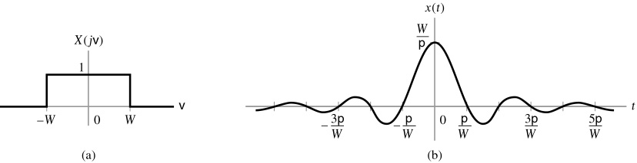
Fourier Representations of Signals & LTI Systems
CHAPTER
3
Example 3.26 Inverse FT of A Rectangular Pulse
Find the inverse FT of the rectangular spectrum depicted in Fig. 3. 42 (a) and given by
Figure 3.42 (p. 246)
Example 3.26. (a) Rectangular spectrum in the frequency domain.
(b) Inverse FT in the time domain.
<Sol.>
v ≡ ω; p ≡ π
1. Inverse FT of x(t):
2. When t = 0, the integral simplifies to W/π, i.e.,

Slide 80
Fourier Representations of Signals & LTI Systems
CHAPTER
3
With understanding that the value at t = 0 is obtained as a limit.
3. Inverse FT is usually written as
or
Fig. 3. 42 (b).
As W increases, the frequency-domain reprsentation becomes less concentrated about ω = 0, while the time-domain representation X(jω) becomes more concentrated about t = 0.
♣ Duality between Example 3.25 and 3.26.
Example 3.27 FT of The Unit Impulse
Find the FT of x(t) = δ(t).
<Sol.>
1. x(t) does not satisfy the Dirichlet conditions, since the discontinuity at the
origin is infinite.
2. FT of x(t):

Slide 81
Fourier Representations of Signals & LTI Systems
CHAPTER
3
♣ Notation for FT pair:
Example 3.28 Inverse FT of An Impulse Spectrum
Find the inverse FT of X(jω) = 2πδ(ω).
<Sol.>
1. Inverse FT of X(jω):
Duality between Example 3.27 and 3.28
2. Notation of FT pair:
Example 3.29 Characteristic of Digital Communication Signals
In a simple digital communication system, one signal or “symbol” is transmitted for each “1” in the binary representation of the message, while a different signal or symbol is transmitted for each “0”. One common scheme, binary phase-shift keying (BPSK), assumes that the signal representing “0” is the negative of the signal and the signal representing “1” is the positive of the signal. Fig. 3.44 depicts two candidate signals for this approach: a rectangular pulse defined as

Slide 82
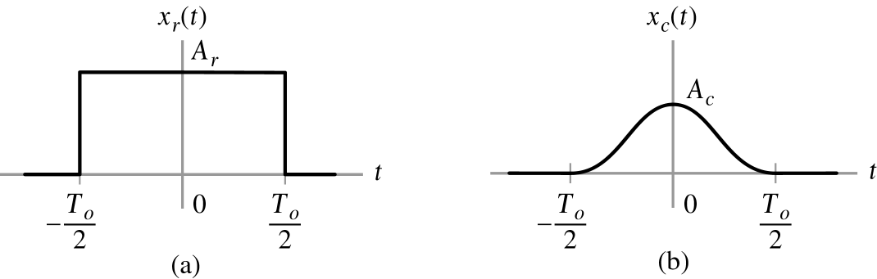
Fourier Representations of Signals & LTI Systems
CHAPTER
3
Figure 3.44 (p. 249)
Pulse shapes used in BPSK communications. (a) Rectangular pulse.
(b) Raised cosine pulse.
and a raised-cosine pulse defined as
The transmitted BPSK signals for communicating a sequence of bits using each pulse shape are illustrated in Fig. 3.45. Note that each pulse is T_{o} seconds long,

Slide 83
Fourier Representations of Signals & LTI Systems
CHAPTER
3
so this scheme has a transmission rate of 1/T_{o} bits per second. Each user’s signal is transmitted within an assigned frequency band, as depicted in Chapter 5. In order to prevent interference with users of other frequency bands, governmental agencies place limits on the energy of a signal that any user transmits into adjacent frequency bands. Suppose the frequency band assigned to each user is 20 kHz wide. Then, to prevent interference with adjacent channels, we assume that the peak value of the magnitude spectrum of the transmitted signal outside the 20-kHz band is required to be − 30 dB below the peak in-band magnitude spectrum. Choose the constant A_{r} and A_{c} so that both BPSK signals have unit power. Use the FT to determine the maximum number of bits per second that can be transmitted when the rectangular and raised-cosine pulse shapes are utilized.
<Sol.>
1. BPSK signals are not periodic, but their magnitude squared is T_{o} periodic.
2. Powers in rectangular pulse and raised-cosine pulse:
and

Slide 84
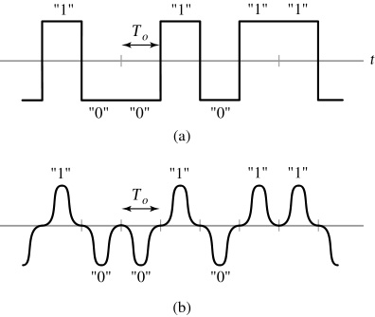
Fourier Representations of Signals & LTI Systems
CHAPTER
3
Figure 3.45 (p. 249)
BPSK signals constructed by using (a) rectangular pulse shapes and (b) raised-cosine pulse shapes.

Slide 85
Fourier Representations of Signals & LTI Systems
CHAPTER
3
Hence, unity transmission power is obtained by choosing A_{r} = 1 and A_{c} = .
3. FT of the rectangular pulse x_{r}(t):
In terms of Hz rather than rad/sec (ω = 2πf):
Fig. 3.46.

Slide 86
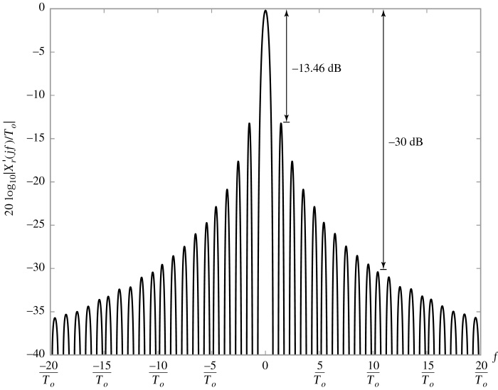
Fourier Representations of Signals & LTI Systems
CHAPTER
3
Figure 3.46
(p. 250)
Spectrum of rectangular pulse in dB, normalized by T₀.
The normalized by T_{o} removed the dependence of the magnitude on T_{o}.

Slide 87
Fourier Representations of Signals & LTI Systems
CHAPTER
3
4. From Fig. 3.46, we must choose To so that the 10 th zero crossing is at 10 kHz
in order to satisfy the constraint that the peak value of the magnitude
spectrum of the transmitted signal outside the 20-kHz band allotted to this
user be less than − 30 dB.
f = k/T_{o}
1000 = 10/T_{o}
T_{o} = 10 ⁻ ³
Data transmission rate = 1000 bits/sec.
5. FT of raised-cosine pulse x_{c}(t):
Euler’s formula
Each of three integrals is of the form
Substituting the appropriate value of γ for each integral

Slide 88
Fourier Representations of Signals & LTI Systems
CHAPTER
3
In terms of f (Hz), the above equation becomes
First term corresponds to the spectrum of the rectangular pulse.
The second and third terms are the versions of 1st term shifted by ± 1/T_{o}.
Fig. 3.47 for T_{o} = 1.
Fig. 3.48.
The normalized by T_{o} removed the dependence of the magnitude on T_{o}.
3) In this case, the peak value of the first sidelobe is below − 30 dB, so we may
satisfy the adjacent channel interference specifications by choosing the
mainlobe to be 20 kHz wide:
f = k/T_{o}
10,000 = 2/T_{o}
T_{o} = 2 × 10 ⁻ ⁴ seconds.
Data transmission rate = 5000 bits/sec.

Slide 89
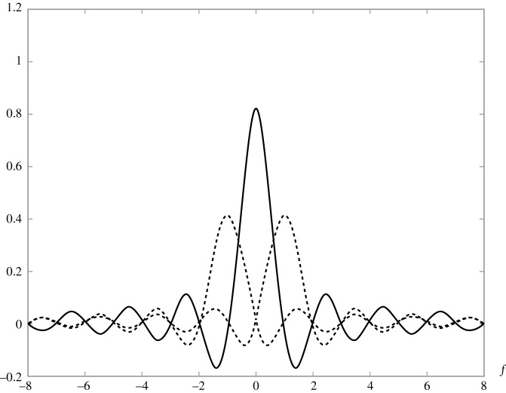
Fourier Representations of Signals & LTI Systems
CHAPTER
3
Figure 3.47 (p. 252)
The spectrum of the raised-cosine pulse consists of a sum of three frequency-shifted sinc functions.

Slide 90
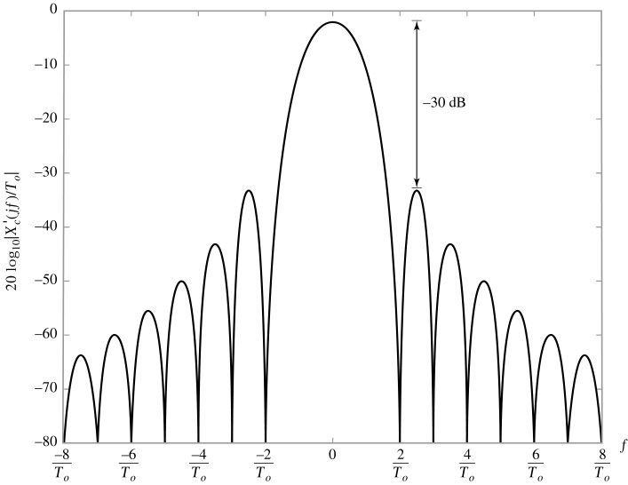
Fourier Representations of Signals & LTI Systems
CHAPTER
3
Figure 3.48 (p. 252)
Spectrum of the raised-cosine pulse in dB, normalized by T₀.

Slide 91
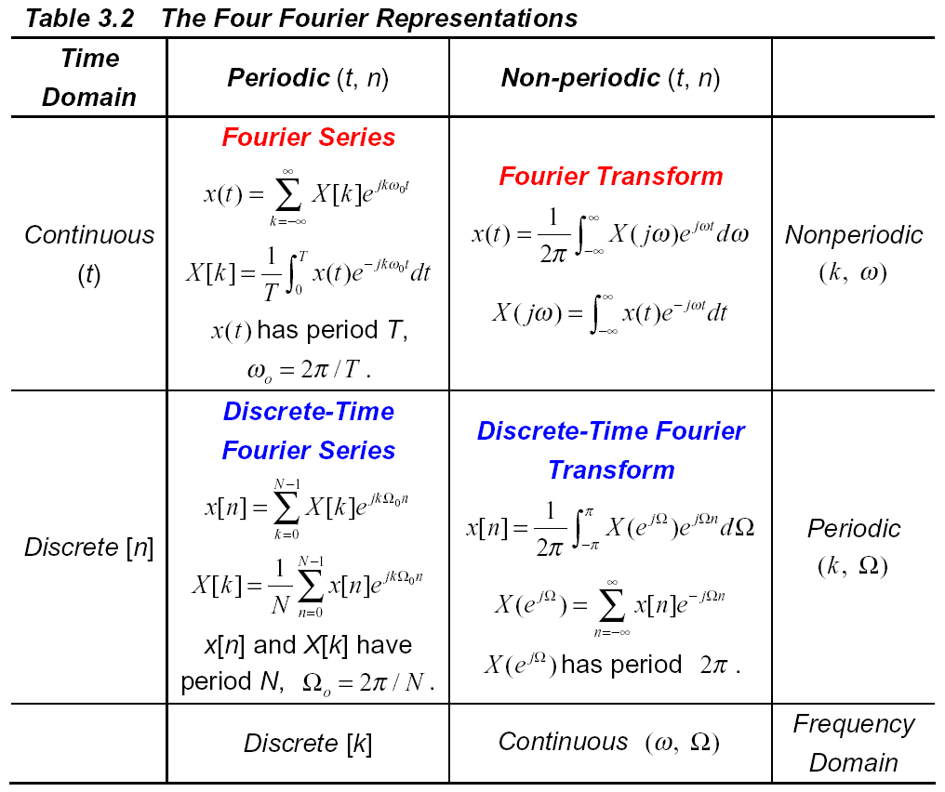
Fourier Representations of Signals & LTI Systems
3.8 Properties of Fourier Representation
1. Four Fourier
representations:
Table

Slide 92
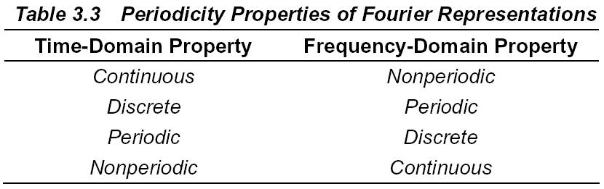
Fourier Representations of Signals & LTI Systems
2. Signals that are periodic in time have discrete frequency-domain
representations, while nonperiodic time signals have continuous frequency-
domain representations:
3.9 Linearity Property
1. Linearity property for four Fourier representations:

Slide 93
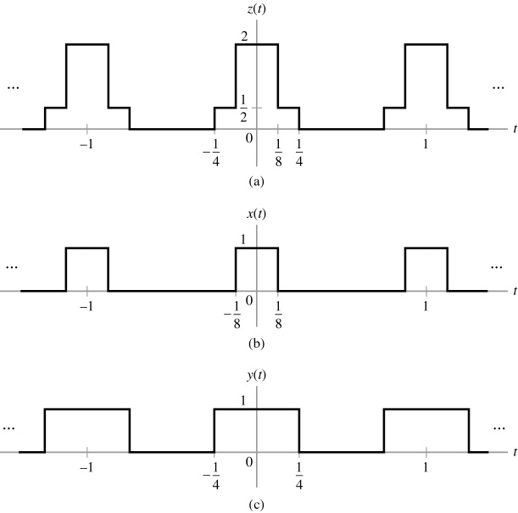
Fourier Representations of Signals & LTI Systems
Example 3.30 Linearity in The FS

Slide 94
Fourier Representations of Signals & LTI Systems

Slide 107
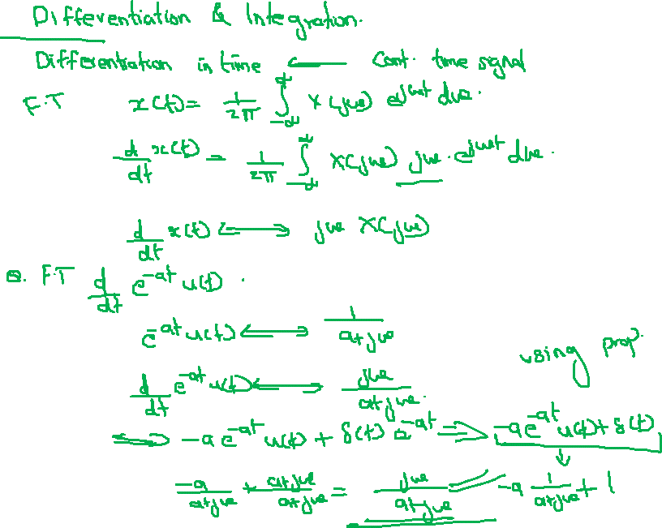

Slide 108
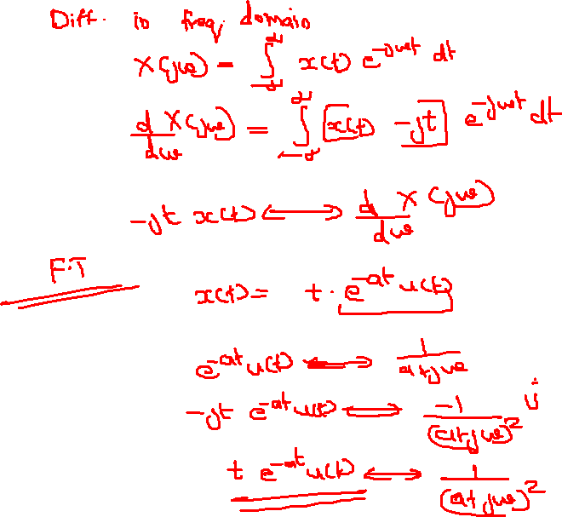

Slide 109
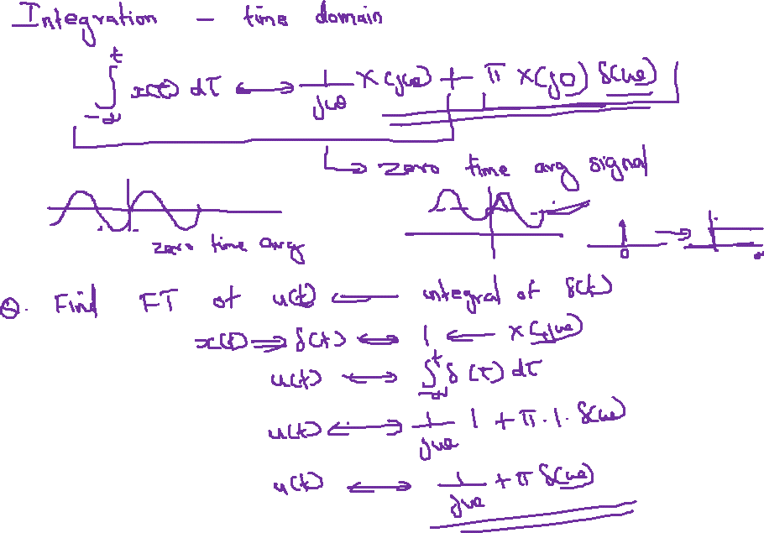

Slide 110
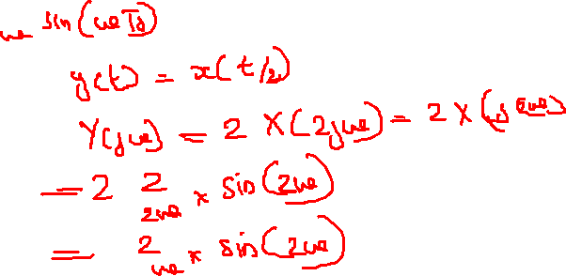


Slide 113
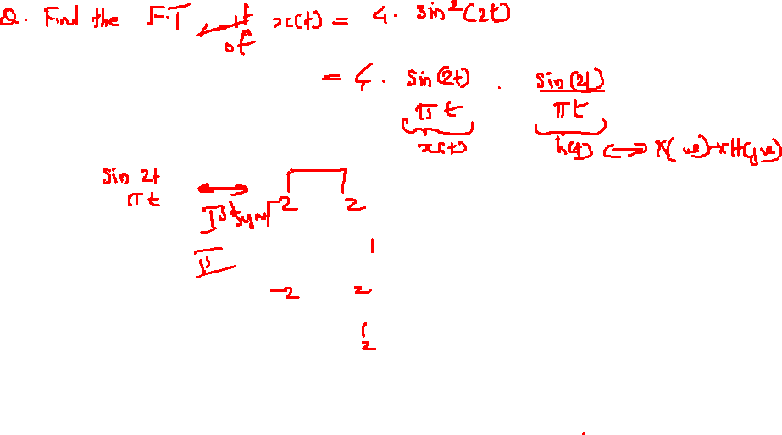

Slide 114
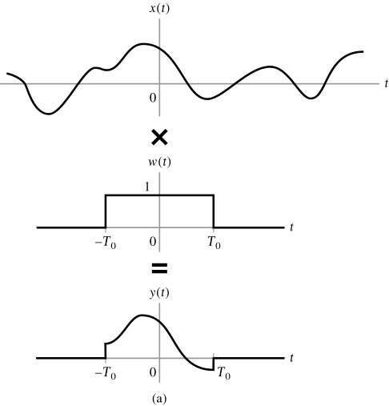
Fourier Representations of Signals & LTI Systems
♣ Multiplication property can
be used to study the effects
of truncating a time-domain
signal on its frequency-
domain.
Windowing !
y(t) = x(t)w(t)

Slide 115
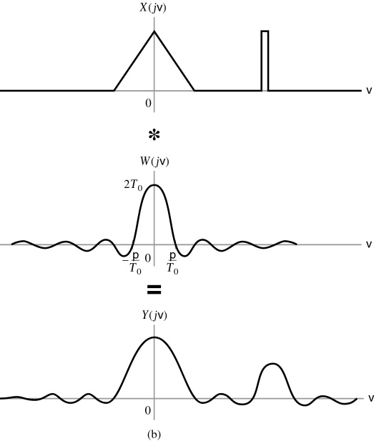
Fourier Representations of Signals & LTI Systems
1. FT of y(t):
p ≡ π ; v ≡ ω
Smoothing the details in X(jω) and introducing oscillation near discontinuities in X(jω).

Slide 124
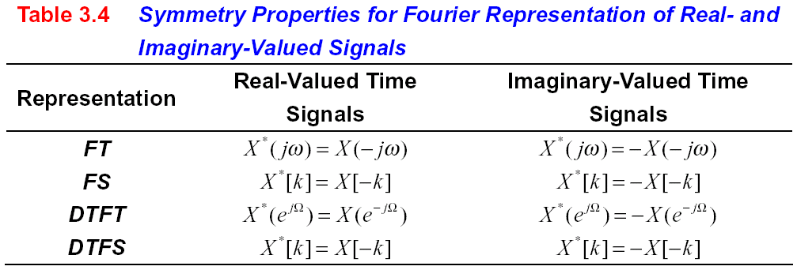
Fourier Representations of Signals & LTI Systems
CHAPTER
3
♦ The conjugate symmetry property for DTFS:
Because the DTFS coefficients are N periodic, and thus
♣ The symmetry conditions in all four Fourier representations of real-valued
signals are indicated in Table 3.4.

Slide 125
Fourier Representations of Signals & LTI Systems
CHAPTER
3
♣ Complex-conjugate symmetry in FT:
A simple characterization of the output of an LTI system with a real-valued impulse response when the input is a real-valued sinusoid.
♦ Continuous-time case:
1. Input signal of LTI system:
Euler’s formula
2. Real-valued impulse response of LTI system is denoted by h(t).
3. Output signal of LTI system:
Exploiting the symmetry conditions:
Applying Eq. (3.2) and linearity

Slide 126
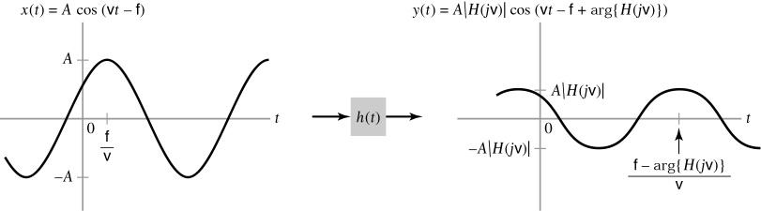
Fourier Representations of Signals & LTI Systems
CHAPTER
3
♣ The LTI system modifies the amplitude of the input sinusoid by ⏐H(jω)⏐and
the phase by arg{H(jω)}.
v ≡ ω; f ≡ φ
Fig. 3.50.
Figure 3.50 (p. 257)
A sinusoidal input to an LTI system results in a sinusoidal output of the same frequency, with the amplitude and phase modified by the system’s frequency response.
♦ Discrete-time case:
1. Input signal of LTI system:
x[n] = Acos(Ω n − φ)

Slide 127
Fourier Representations of Signals & LTI Systems
CHAPTER
3
2. Real-valued impulse response of LTI system is denoted by h[n].
3. Output signal of LTI system:
♣ The LTI system modifies the amplitude of the input sinusoid by ⏐H(e ^{jΩ})⏐and
the phase by arg{H(e ^{jΩ})}.
♦ x(t) is purely imaginary:
1. x∗(t) = − x(t).
2. Eq.(3.37) becomes
(3.39)
3.9.2 Symmetry Properties: Even and Odd Signals
1. x(t) is real valued and has even symmetry.
x∗(t) = x(t) and x (− t) = x(t)
x∗(t) = x(− t)

Slide 128
Fourier Representations of Signals & LTI Systems
CHAPTER
3
2. Eq.(3.37) becomes
Change of variable τ = − t
3. Conclusion:
1) The imaginary part of X(jω) = 0:
If x(t) is real and even, then X(jω) is real.
2) If x(t) is real and odd, then X∗(jω) = − X(jω) and X(jω) is imaginary.
3.10 Convolution Properties
♣ The convolution property is a consequence of complex sinusoids being
eigenfunctions of LTI system.
3.10.1 Convolution of Nonperiodic Signals — Continuous-time case
1. Convolution of two nonperiodic continuous-time signals x(t) and h(t):
2. FT of x(t − τ):

Slide 129
Fourier Representations of Signals & LTI Systems
CHAPTER
3
3. Substituting this expression into the convolution integral yields
The inner integral over τ as the FT of h(τ), or H(jω). Hence, y(t) may be written as
and we identify H(jω)X(jω) as the FT of y(t).
(3.40)
Example 3.31 Solving A Convolution Problem in The Frequency Domain
Let x(t) = (1/(πt))sin(πt) be the input to a system with impulse response h(t) = (1/(πt))sin(2πt). Find the output y(t) = x(t) ∗ h(t).

Slide 130
Fourier Representations of Signals & LTI Systems
CHAPTER
3
<Sol.>
x(t) = (1/(πt))sin(πt)
1. Solving problem:
h(t)
y(t) = x(t) ∗ h(t)
Time domain → Extremely Difficult
Frequency domain → Quite Simple
Convolution property
2. From Example 3.26, we have
and
Since
y(t) = (1/(πt))sin(πt)
Example 3.32 Finding Inverse FT’s by Means of The Convolution Property
Use the convolution property to find x(t), where

Slide 131
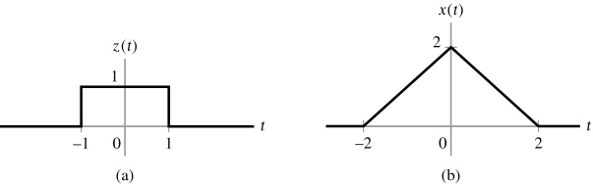
Fourier Representations of Signals & LTI Systems
CHAPTER
3
<Sol.>
1. Write X(jω) = Z(jω) Z(jω), where
2. Convolution property:
Fig. 3.52 (a)
3. Using the result of Example 3.25:
4. Performing the convolution with itself gives the triangular waveform depicted
in Fig. 3.52 (b) as the solution for x(t).
Figure 3.52 (p. 261)
Signals for Example 3.32. (a) Rectangular pulse z(t). (b) Convolution of z(t) with itself gives x(t).

Slide 132
Fourier Representations of Signals & LTI Systems
CHAPTER
3
♣ Convolution of Nonperiodic Signals — Continuous-time case
If
and
(3.41)
3.10.2 Filtering
1. Multiplication in frequency domain ↔ Filtering.
2. The terms “filtering” implies that some frequency components of the input
are eliminated while others are passed by the system unchanged.
3. System Types of filtering:
Fig. 3.53 (a), (b), and (c)
Low-pass filter
High-pass filter
Band-pass filter
The characterization of DT filter is based on its behavior in the frequency range − π < Ω ≤ π because its frequency response is 2 π-periodic.
4. Realistic filter:
Gradual transition band
Nonzero gain of stop band
5. Magnitude response of filter:
or
[dB]

Slide 133
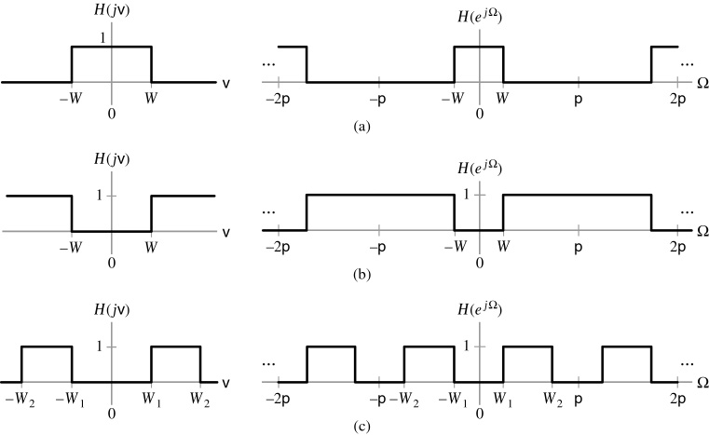
Fourier Representations of Signals & LTI Systems
CHAPTER
3
v ≡ ω; p ≡ π
Figure 3.53 (p. 263)
Frequency response of ideal continuous- (left panel) and discrete-time (right panel) filters. (a) Low-pass characteristic. (b) High-pass characteristic. (c) Band-pass characteristic.

Slide 134
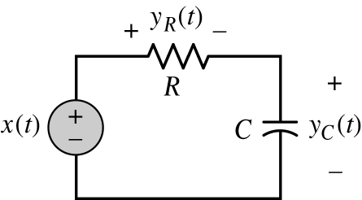
Fourier Representations of Signals & LTI Systems
CHAPTER
3
6. The edge of the passband is usually defined by the frequencies for which
the response is − 3 dB, corresponding to a magnitude response of (1/ ).
♣ Unity gain = 0 dB
7. Energy spectrum of filter:
The − 3 dB point corresponds to frequencies at which the filter passes only half of the input power.
− 3 dB point
Cutoff frequency
Example 3.33 RC Circuit: Filtering
For the RC circuit depicted in Fig. 3.54, the impulse response for the case where y_{C}(t) is the output is given by
Since y_{R}(t) = x(t) − y_{C}(t), the impulse response for the case where y_{R}(t) is the output is given by
Figure 3.54 (p. 264)
RC circuit with input x(t) and outputs y_{c(t)} and y_{R}(t).

Slide 135
Fourier Representations of Signals & LTI Systems
CHAPTER
3
Plot the magnitude responses of both systems on a linear scale and in dB, and characterize the filtering properties of the systems.
<Sol.>
1. Frequency response corresponding to h_{C}(t):
2. Frequency response corresponding to h_{R}(t):
3. Magnitude response in linear scale: Fig. 3-55 (a) and (b).
Magnitude response in dB scale: Fig. 3-55 (c) and (d).
4. System corresponding to y_{C}(t):
Low-pass filter
Cutoff frequency = ω_{c} = 1/(RC)
System corresponding to y_{R}(t):
High-pass filter
Cutoff frequency = ω_{c} = 1/(RC)

Slide 136
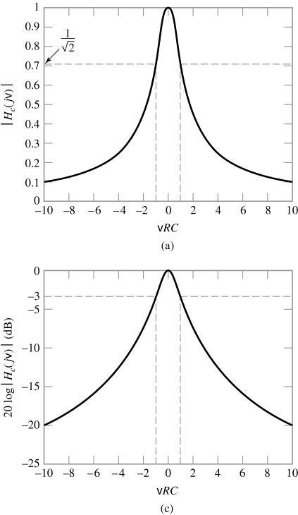
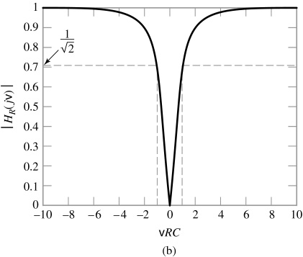
Fourier Representations of Signals & LTI Systems
CHAPTER
3
v ≡ ω
Figure 3.55 (p. 265)
RC circuit magnitude responses as a function of normalized frequency ωRC. (a) Frequency response of the system corresponding to y_{C}(t), linear scale.
(b) Frequency response of the system corresponding to y_{R}(t), linear scale.

Slide 137
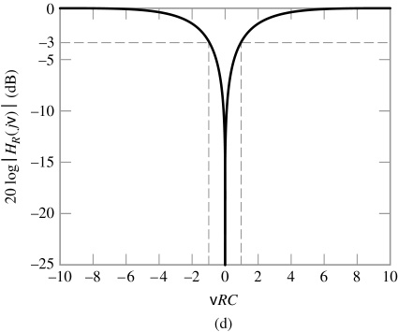
Fourier Representations of Signals & LTI Systems
CHAPTER
3
v ≡ ω
Figure 3.55a&c (p. 265)
RC circuit magnitude responses as a function of normalized frequency ωRC.
(c) Frequency response of the system corresponding to y_{C}(t), dB scale.
(d) Frequency response of the system corresponding to y_{R}(t), dB scale, shown on the range from 0 dB to –25 dB.

Slide 138
Fourier Representations of Signals & LTI Systems
CHAPTER
3
The convolution property implies that the frequency response of a system
may be expressed as the ratio of the FT or DTFT of the output to the input .
For CT system:
(3.42)
Frequency response
For DT system:
(3.43)
Example 3.34 Identifying a System, Given Its Input and Output
The output of an LTI system in response to an input x(t) = e ^{− 2 t} u(t) is y(t) =
e ^{− t} u(t) . Find the frequency response and the impulse response of this system.
<Sol.>
1. FT of x(t) and y(t):
and
2. Frequency response:

Slide 139
Fourier Representations of Signals & LTI Systems
CHAPTER
3
3. Impulse response:
♣ Recover the input of the system from the output:
CT case
DT case
and
where
and
◆ An inverse system is also known as an equalizer, and the process of
recovering the input from the output is known as equalization.
◆ Causality restriction → An exact inverse system is difficult or impossible
to be implemented!
Ex. Time delay in communication system need an equalizer to introduce a time
advance.
Equalizer is a noncausal system and cannot in fact be implemented!
Approximation!

Slide 140
Fourier Representations of Signals & LTI Systems
CHAPTER
3
Example 3.35 Multipath Communication Channel: Equalization
Consider again the problem addressed in Example 2.13. In this problem, a distorted received signal y[n] is expressed in terms of a transmitted signal x[n] as
Use the convolution property to find the impulse response of an inverse system that will recover x[n] from y[n].
<Sol.>
1. In Example 2.13, we have y[n] = x[n] ∗ h[n], where the impulse response is
2. The impulse response of an inverse system, h^{inv}[n], must satisfy

Slide 141
Fourier Representations of Signals & LTI Systems
CHAPTER
3
Frequency response of inverse system
3. DTFT of h[n]:
The frequency response of the inverse system is then obtained as
3.10.3 Convolution of Periodic Signals
♣ Basic Concept:
Periodic h
Unstable system

Slide 142
Fourier Representations of Signals & LTI Systems
CHAPTER
3
Define the periodic convolution of two CT signals x(t) and z(t), each having
period T, as
where the symbol  denotes that integration is performed over a single period of the signals involved.
(3.44)
◆ Convolution in Time-Domain ↔ Multiplication in Frequency-Domain
Example 3.36 Convolution of Two Periodic Signals
Evaluate the periodic convolution of the sinusoidal signal
with the periodic square wave x(t) depicted in Fig. 3.56.
<Sol.>
1. Both x(t) and z(t) have fundamental period T = 1.
2. Let

Slide 143
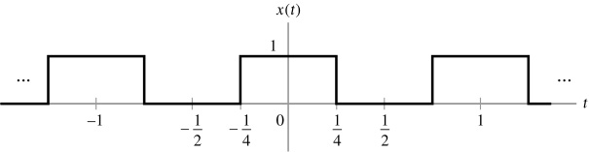
Fourier Representations of Signals & LTI Systems
CHAPTER
3
Figure 3.56 (p. 268)
Square wave for Example 3.36.
3. Coefficients of FS representation of z(t):
Coefficients of FS representation of x(t):
Example 3.13

Slide 144
Fourier Representations of Signals & LTI Systems
CHAPTER
3
3. FS Coefficients of y(t):
♣ Explanation for the origin of the Gibbs phenomenon:
Example 3.14:
1. A partial-sum approximation to the FS representation for x(t) may be obtained
by using the FS coefficients
T = 1
where
2. In the time domain, is the periodic convolution of x(t) and
T = 1
(3.45)

Slide 145
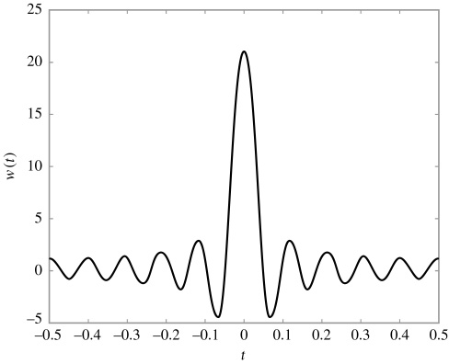
Fourier Representations of Signals & LTI Systems
CHAPTER
3
3. One period of the
signal w(t) is depicted
in Fig. 3.57 for J = 10.
4. The periodic convolution
of x(t) and w(t) is the area
under time-shifted version
of w(t) on ⏐t⏐< ½ .Time-
shifting the sidelobes of w(t)
into and out of the interval
⏐t⏐< ½ introduces ripples
the partial-sum
approximation .
5. As J increases, the mainlobe
and sidelobe widths in w(t)
decrease, but the size of the
sidelobe does not change.
Figure 3.57 (p. 270)
The signal z(t) defined in Eq. (3.45) when J = 10.
This is why the ripples in becomes more concentrated near discontinuity of x(t), but remain the same magnitude.

Slide 146
Fourier Representations of Signals & LTI Systems
CHAPTER
3
Define the discrete-time convolution of two N-periodic sequences x[n] and
z[n] as
DTFS of y[n]
(3.46)
◆ Convolution in Time-Domain ↔ Multiplication in Frequency-Domain
◆ The convolution properties of all four Fourier representation are summarized
in Table 3.5.
Table 3.5 Convolution Properties

Slide 147
Fourier Representations of Signals & LTI Systems
CHAPTER
3
3.11 Differentiation and Integration Properties
♣ Differentiation and integration are operations that apply to continuous functions.
3.11.1 Differentiation in Time
1. A nonperiodic signal x(t) and its FT, X(jω), is related by
Differentiating both sides with respect to t
◆ Differentiation of x(t) in Time-Domain ↔ (jω) × X(jω) in Frequency-Domain
Example 3.37 Verifying the Differentiation Property
The differentiation property implies that
Verify this result by differentiating and taking the FT of the result.

Slide 148
Fourier Representations of Signals & LTI Systems
CHAPTER
3
<Sol.>
1. Using the product rule for differentiation, we have
2. Taking the FT of each term and using linearity, we may write
♣ Frequency response of a continuous system
1. System equation in terms of differential equation:
Taking FT of both sides
(3.47)
2. Frequency response of the system:

Slide 149
Fourier Representations of Signals & LTI Systems
CHAPTER
3
Example 3.38 MEMS Accelerometer: Frequency Response and Resonance
The MEMS accelerometer introduced in Section 1.10 is described by the differential equation
Find the frequency response of this system and plot the magnitude response in dB for ω_{n} = 10,000 rads/s for (a) Q = 2/5, (b) Q = 1, and (c) Q = 200.
<Sol.>
1. Frequency response:
2. Magnitude response for (a) Q = 2/5, (b) Q = 1, and (c) Q = 200: Fig. 3.58.
♣ Discussion: Refer to textbook, p. 273.
ω_{n} = 10,000 rads/s → Resonant condition!

Slide 150
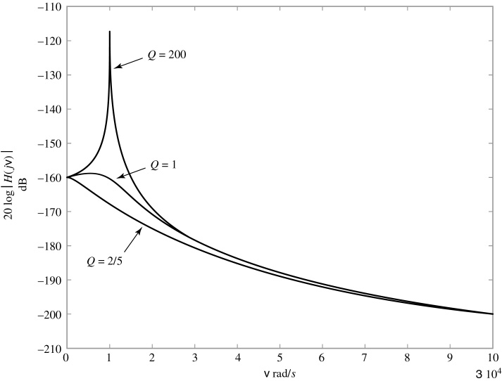
Fourier Representations of Signals & LTI Systems
CHAPTER
3
v ≡ ω
Figure 3.58 (p. 273)
Magnitude of frequency response in dB for MEMS accelerometer for ω_{n} = 10,000 rad/s, Q = 2/5, Q = 1, and Q = 200.

Slide 151
Fourier Representations of Signals & LTI Systems
CHAPTER
3
♣ The Differentiation property for a periodic signal
1. The FS representation of a periodic signal x(t):
Differentiating both sides with respect to t
2. Differentiation property of a periodic signal:
◆ Differentiation of x(t) in Time-Domain ↔ (jkω₀) × X[k] in Frequency-Domain
Example 3.39 Differentiation Property
Use the differentiation property to find the FS representation of the triangular wave depicted in Fig. 3. 59 (a).
<Sol.>
Fig. 3. 59 (b)
1. Define a waveform:

Slide 152
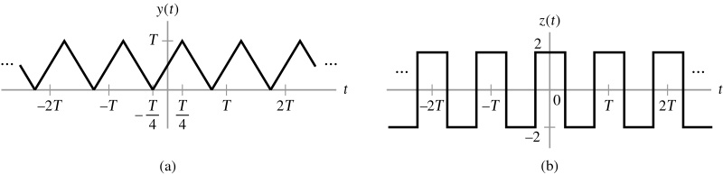
Fourier Representations of Signals & LTI Systems
CHAPTER
3
Figure 3.59 (p. 274)
Signals for Example 3.39. (a) Triangular wave y(t). (b) The derivative of y(t) is the square wave z(t).
2. Comparing z(t) in Fig. 3. 59 (b) and the sqare wave x(t) with T₀/T = ¼ in
Example 3.13, we have

Slide 153
Fourier Representations of Signals & LTI Systems
CHAPTER
3
3. The differentiation property implies that
Except for k = 0
The quantity Y[0] is the average value of y(t) and is determined by inspection Fig. 3.59 (b) to be T/2.
Therefore,
3.11.2 Differentiation in Frequency
1. FT of signal x(t):
Differentiating both sides with respect to ω
2. Differentiation property in frequency domain:

Slide 154
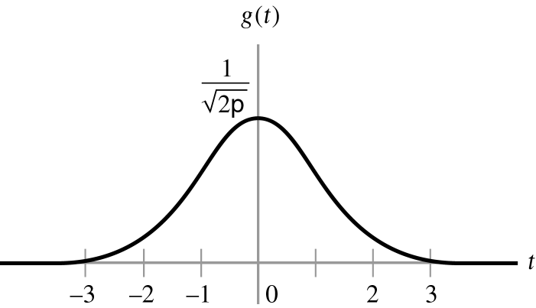
Fourier Representations of Signals & LTI Systems
CHAPTER
3
◆ Differentiation of X(jω) in Frequency-Domain ↔ (− jt) × x(t) in Time-Domain
Example 3.40 FT of a Gaussian Pulse
Use the differentiation-in-time and differentiation-in-frequency properties to determine the FT of the Gaussian pulse, depicted in Fig. 3.60 and defined by
D.E. of g(t)
<Sol.>
p ≡ π
1. The derivative of g(t) with respect to t:
(3.48)
2. Differentiation-in-time property:
(3.48)
Figure 3.60 (p. 275)
Gaussian pulse g(t).
(3.49)
3. Differentiation-in-time property:

Slide 155
Fourier Representations of Signals & LTI Systems
CHAPTER
3
(3.50)
Since the left-hand sides of Eqs. (3.49) and (3.50) are equal, then we have
D.E. of G(jω)
4. The integration constant c is determined by noting that (see Appendix A-4)
The FT of a Gaussian pulse is also a Gaussian pulse!
3.11.3 Integration
♣ The operation of integration applies only to continuous dependent variables.
In both FT and FS, we may integrate with respect to time.
In both FT and DTFT, we may integrate with respect to frequency.

Slide 156
Fourier Representations of Signals & LTI Systems
CHAPTER
3
♣ Case for nonperiodic signal
1. Define
(3.51)
2. By differentiation property, we have
Indeterminate at ω = 0
X(j0) = 0
(3.52)
3. When the average value of x(t) is not zero, then it is possible that y(t) is not
square integrable.
FT of y(t) may not converge!
W can get around this problem by including impulse in the transform, i.e.
c can be determined by the average value of x(t)
C = π X(j0)
4. General form of integration property:

Slide 157
Fourier Representations of Signals & LTI Systems
CHAPTER
3
(3.53)
Ex. Demonstration for the integration property by deriving the FT of the unit step
1. Unit step signal:
2. FT of δ (t):
3. Eq. (3.53) suggests that:
♣ Check:
1. Unit step:
(3.54)
Fig. 3.61
2. Signum function:

Slide 158
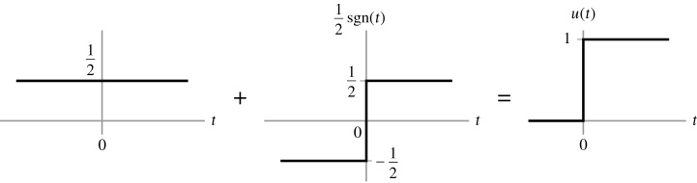
Fourier Representations of Signals & LTI Systems
CHAPTER
3
Figure 3.61 (p. 279)
Representation of a step function as the sum of a constant and a signum function.
3. Using the results of Example 3.28:
The transform of sgn(t) may be derived using the differentiation property because it has a zero time-average value.
Let
We know that S(j0) = 0. This knowledge removes the indeterminacy at ω = 0 associated with differentiation property, and we conclude that

Slide 159
Fourier Representations of Signals & LTI Systems
CHAPTER
3
This relationship can be written as S(jω) = 2/j ω with the understanding that S(j0) = 0.
4. Applying the linearity property to Eq. (3.54) gives the FT of u(t):
This agrees exactly with the transform of the unit step obtained by using the integration property.
Table 3.6 Commonly Used Differentiation and Integration Properties.
◆ The differentiation
and integration
properties of Fourier
representation are
summarized in
Table 3.6.

Slide 160
Fourier Representations of Signals & LTI Systems
CHAPTER
3
3.12 Time- and Frequency-Shift Properties
3.12.1 Time-Shift Property
1. Let z(t) = x(t − t₀) be a time-shifted version of x(t).
2. FT of z(t):
3. Change variable by τ = t − t₀:
◆ Time-shifting of x(t) by t₀ in Time-Domain
↔ (e ^{− jω t0}) × X(jω) in Frequency-Domain
and
◆ The time-shifting properties of four Fourier representation are summarized
in Table 3.7.

Slide 161
Fourier Representations of Signals & LTI Systems
CHAPTER
3
Table 3.7 Time-Shift Properties of Fourier Representations
Example 3.41 Finding an FT Using the Time-Shift Property
Use the FT of the rectangular pulse x(t) depicted in Fig. 3.62 (a) to determine the FT of the time-shift rectangular pulse z(t) depicted in Fig. 3. 62 (b).
<Sol.>
1. Note that z(t) = x(t − T₁).
2. Time-shift property:

Slide 162
Fourier Representations of Signals & LTI Systems
CHAPTER
3
3. In Example 3.25, we obtained
♣ Frequency response of a discrete-time system
1. Difference equation:
Taking DTFTof both sides of this equation

Slide 163
Fourier Representations of Signals & LTI Systems
CHAPTER
3
2. Frequency response:
(3.55)
The problem is to express the inverse FT of Z(jω) = X(j(ω − γ )) in terms of x(t).
3.12.2 Frequency-Shift Property
1. Suppose that:
and
2. By the definition of the inverse FT, we have
Substituting variables η = ω − γ into above Eq. gives
◆ Frequency-shifting of X(jω) by γ in Frequency-Domain [i.e. X(j(ω − γ ))]
↔ (e ^{− γ t}) × x(t) in Time-Domain

Slide 164
Fourier Representations of Signals & LTI Systems
CHAPTER
3
◆ The frequency-shift properties of Fourier representations are
summarized in Table 3.8.
Table 3.8 Frequency-Shift Properties of Fourier Representations
Example 3.42 Finding an FT by Using the Frequency-Shift Property
Use the frequency-shift property to determine the FT of the complex sinusoidal pulse:
<Sol.>
1. Express z(t) as the product of a complex sinusoid e^{j10t} and a rectangular pulse

Slide 165
Fourier Representations of Signals & LTI Systems
CHAPTER
3
2. Use the results of Example 3.25, we have
Frequency-shift property
3. FT of z(t):
Example 3.43 Using multiple Properties to Find an FT
Find the FT of the signal
<Sol.>
1. To solve this problem, it needs to use three properties: differentiation in time,
convolution, and time shifting.

Slide 166
Fourier Representations of Signals & LTI Systems
CHAPTER
3
2. Let
and
Convolution and differentiation property
3. From the transform pair:
4. Use the same transform pair and the time-shift property to find V(jω) by first
writing
5. FT of x(t):

Slide 167
Fourier Representations of Signals & LTI Systems
CHAPTER
3
3.13 Finding Inverse Fourier Transforms by Using Partial-
Fraction Expansions
Frequency response
A ratio of two polynomials in jω or e ^{j Ω}
3.13.1 Inverse Fourier Transform
1. FT X(jω) in terms of a ratio of polynomials in jω:
Assume that M < N. If M ≥ N, then we may use long division to express X(jω) in the form
Partial-fraction expansion is applied to this term
Applying the differentiation property and the pair to these terms
2. Let the roots of the denominator
A(jω) be d_{k}, k = 1, 2, …, N. These
roots are found by replacing jω
with a generic variable v and
determining the roots of the polynomial

Slide 168
Fourier Representations of Signals & LTI Systems
CHAPTER
3
5. For M < N, we may the write
C_{k}, k = 1, 2, …, N are determined by the method of residues
Assuming that all the roots d_{k}, k = 1, 2, …, N, are distinct, we may write
Appendix B
In Example 3.24, we derived the transform pair
This pair is valid even if d is complex, provided that Re{d} < 0.
Assuming that the real part of each d_{k}, k = 1, 2, …, N, is negative, we use linearity to write

Slide 169
Fourier Representations of Signals & LTI Systems
CHAPTER
3
Example 3.44 MEMS Accelerometer: Impulse Response
Find the impulse response for the MEMS accelerometer introduced in Sec. 1.10, assuming that ω_{n} = 10,000 rads/s, and (a) Q = 2/5, (b) Q = 1, and (c) Q = 200.
<Sol.>
♣ Frequency response for the MEMS accelerometer:
Case (a): ω_{n} = 10,000 rads/s and Q = 2/5
1. Frequency response:

Slide 170
Fourier Representations of Signals & LTI Systems
CHAPTER
3
2. Partial-fraction expansion:
The roots of the denominator polynomial are d₁ = − 20,000 and d₂ = − 5,0000.
Coefficients C₁ and C₂:

Slide 171
Fourier Representations of Signals & LTI Systems
CHAPTER
3
3. Impulse response:
Case (b): ω_{n} = 10,000 rads/s and Q = 1
1. Frequency response:
2. Partial-fraction expansion:
The roots of the denominator polynomial are
3. Impulse response:

Slide 172
Fourier Representations of Signals & LTI Systems
CHAPTER
3
Case (c): ω_{n} = 10,000 rads/s and Q = 200
1. Frequency response:
The roots of the denominator polynomial are
2. Impulse response:
♣ Impulse response for (a) Q = 2/5, (b) Q = 1, and (c) Q = 200: Fig. 3.64 (a) ~ (c).
1. For both Q = 2/5 and Q = 1, the impulse response is approximately zero for
t > 1 ms.
2. When Q = 200, the accelerometer exhibits resonant nature.
A sinusoidal oscillation of ω_{n} = 10,000 rads/sec.

Slide 173

Fourier Representations of Signals & LTI Systems
CHAPTER
3
Figure 3.64 (p. 289)
Impulse response of MEMS accelerometer.

Slide 174
Fourier Representations of Signals & LTI Systems
CHAPTER
3
3.13.2 Inverse Discrete-Time Fourier Transform
1. Suppose X(e ^{j Ω}) is given by a ratio of polynomial in e ^{j Ω}, i.e.
Normalized to 1
2. Factor the denominator polynomial as
Replace e ^{j Ω} with the generic variable v:
Find d_{k}, the roots of this polynomial
3. Partial-fraction expansion:
Assuming that M < N and all the d_{k} are distinct, we may express X(e ^{j Ω})as
Since

Slide 175
Fourier Representations of Signals & LTI Systems
CHAPTER
3
Expansions for repeated roots are treated in Appendix B.
The linearity property implies that
Example 3.45 Inverse by Partial-Fraction Expansion
Find the inverse DTFT of
<Sol.>
1. Characteristic polynomial:
2. The roots of above polynomial: d₁ = − 1/2 and d₂ = 1/3.
3. Partial-Fraction Expansion:

Slide 176
Fourier Representations of Signals & LTI Systems
CHAPTER
3
Coefficients C₁ and C₂

Slide 177
Fourier Representations of Signals & LTI Systems
CHAPTER
3
3.14 Multiplication Property
♣ Non-periodic continuous-time signals
1. Non-periodic signals: x(t), z(t), and y(t) = x(t)z(t).
Find the FT of y(t).
2. FT of x(t) and z(t):
and
Change variable: η = ω − v
Inner Part: Z(jω) ∗ X(jω)
3. FT of y(t):
Outer Part: FT of y(t)
(3.56)
Scaled by 1/2π

Slide 178
Fourier Representations of Signals & LTI Systems
CHAPTER
3
where
◆ Multiplication of two signals in Time-Domain
↔ Convolution in Frequency-Domain × (1/2π)
♣ Non-periodic continuous-time signals
Find the DTFT of y[n].
1. Non-periodic DT signals: x[n], z[n], and y[n] = x[n]z[n].
2. DTFT of y[n]:
(3.57)
where the symbol  denotes periodic convolution.
Here, X(e ^{j Ω}) and X(e ^{j Ω}) are 2π-periodic, so we evaluate the convolution over a 2π interval:
◆ Multiplication of two signals in Time-Domain
↔ Convolution in Frequency-Domain × (1/2π)

Slide 179
Fourier Representations of Signals & LTI Systems
CHAPTER
3
♣ Multiplication property can
be used to study the effects
of truncating a time-domain
signal on its frequency-
domain.
Windowing !
♣ Truncate signal x(t) by a
window function w(t) is
represented by
y(t) = x(t)w(t)
Fig. 3. 65 (a)
Figure 3.65a (p. 293)
The effect of windowing.
(a) Truncating a signal in time by using a window function w(t).

Slide 180
Fourier Representations of Signals & LTI Systems
CHAPTER
3
1. FT of y(t):
2. If w(t) is the rectangular window depicted
in Fig. 3. 65 (b), we have
p ≡ π ; v ≡ ω
Smoothing the details in X(jω) and introducing oscillation near discontinuities in X(jω).
Figure 3.65b (p. 293)
(b) Convolution of the signal and window FT’s resulting from truncation in time.

Slide 181
Fourier Representations of Signals & LTI Systems
CHAPTER
3
♣ The smoothing is a consequence of the 2π/T₀ width of the mainlobe of W(jω),
while the oscillations near the discontinuities are due to the oscillations in
the sidelobes of W(jω).
Example 3.46 Truncating the Impulse Response
The frequency response H(e ^{jΩ}) of an ideal discrete-time system is depicted in Fig. 3. 66 (a). Describe the frequency response of a system whose impulse response is the ideal system impulse response truncated to the interval − M ≤ n ≤ M.
<Sol.>
1. The ideal impulse response is the inverse DTFT of H(e ^{jΩ} ).
Using the result of Example 3.19, we write
2. Let h_{t}[n] be the truncated impulse response:

Slide 182

Fourier Representations of Signals & LTI Systems
CHAPTER
3
v ≡ ω, u ≡ θ
Figure 3.66 (p. 294)
The effect of truncating the impulse response of a discrete-time system.
(a) Frequency response of ideal system. (b) F_{Ω}(θ) for Ω near zero.

Slide 183
Fourier Representations of Signals & LTI Systems
CHAPTER
3
v ≡ ω, u ≡ θ
H_{t}(e ^{jΩ} ) is the area under F_{Ω}(θ ) between θ = − π/2 and θ = π/2.
Figure 3.66 (p. 294)
The effect of truncating the impulse response of a discrete-time system. (c) F_{Ω}(θ) for Ω slightly greater than π/2.(d) Frequency response of system with truncated impulse response.

Slide 184
Fourier Representations of Signals & LTI Systems
CHAPTER
3
3. Let
Using the multiplication property in Eq. (3.57), we have
4. Since
On the basis of Example 3.18
and
Discussion: refer to p. 295 in textbook.
where we have defined

Slide 185
Fourier Representations of Signals & LTI Systems
CHAPTER
3
♣ Multiplication of periodic time-domain signals corresponds to convolution
of the Fourier representations.
Same fundamental periods of x(t) and z(t)
(3.58)
where
Non-periodic convolution of the FS coefficients
♣ x(t) 與 z(t)基本週期不同時，FS係數 X[k]與 Z[k]需取兩信號基本週期的最小
公倍數(Least common multiple)週期。
Example 3.47 Radar Range Measurement: Spectrum of RF Pulse Train
The RF pulse train used to measure the range and introduced in Section 1.10 may be defined as the product of a square wave p(t) and a sine wave s(t), as shown in Fig. 3.68. Assume that s(t) = sin (1000πt/T). Find the FS coefficients of x(t).
<Sol.>
1. Suppose that s(t) = p(t) x(t).
Multiplication property

Slide 186

Fourier Representations of Signals & LTI Systems
CHAPTER
3
Figure 3.68 (p. 297)
The RF pulse is expressed as the product of a periodic square wave and a sine wave.

Slide 187
Fourier Representations of Signals & LTI Systems
CHAPTER
3
2. Fundamental period:
Fundamental frequency
For p(t): ω₀ = 2π/T.
s(t) = sin (1000πt/T) = sin(500ω₀t ).
3. FS coefficients of s(t):
4. FS coefficients of p(t):
Result of Example 3.13
Time-shift property
5. FS coefficients of x(t):
6. Fig. 3.69 depicts the magnitude spectrum for 0 ≤ k ≤ 1000.

Slide 188

Fourier Representations of Signals & LTI Systems
CHAPTER
3
Figure 3.69 (p. 298)
FS magnitude spectrum for 0 ≤ k ≤ 1000. The result is depicted as a continuous curve, due to the difficulty of displaying 1000 stems

Slide 189
Fourier Representations of Signals & LTI Systems
CHAPTER
3
♣ Multiplication property for discrete-time periodic signals:
(3.59)
where
Periodic convolution of DTFS coefficients
◆ Fundamental period = N.
◆ The multiplication properties of all four Fourier representations are
summarized in Table 3.9.
Table 3.9 Multiplication Properties of Fourier Representations

Slide 190
Fourier Representations of Signals & LTI Systems
CHAPTER
3
3.15 Scaling Property
1. Let z(t) = x(at).
2. FT of z(t) :
Changing variable: τ = at
(3.60)
◆ Scaling in Time-Domain ↔ Inverse Scaling in Frequency-Domain
Signal expansion or compression!
Refer to Fig. 3.70.

Slide 191

Fourier Representations of Signals & LTI Systems
CHAPTER
3
v ≡ ω
Figure 3.70 (p. 300)
The FT scaling property. The figure assumes that 0 < a < 1.

Slide 192
Fourier Representations of Signals & LTI Systems
CHAPTER
3
Example 3.48 Scaling a Rectangular Pulse
Let the rectangular pulse
Use the FT of x(t) and the scaling property to find the FT of the scaled rectangular pulse
<Sol.>
1. Substituting T₀ = 1 into the result of Example 3. 25 gives
Scaling property and a = 1/2
2. Note that y(t) = x(t/2).
Fig. 3.71
♣ Substituting T₀ = 2 into the result of Example 3.25 can also give the answer!
Example 3.49 Using Multiple Performance to Find an Inverse FT
Find x(t) if

Slide 193

Fourier Representations of Signals & LTI Systems
CHAPTER
3
Figure 3.71
(p. 301)
Application of the FT scaling property in Example 3.48. (a) Original time signal. (b) Original FT. (c) Scaled time signal y(t) = x(t/2). (d) Scaled FT Y(jω) = 2X(j2ω).
v ≡ ω

Slide 194
Fourier Representations of Signals & LTI Systems
CHAPTER
3
<Sol.>
1. Differentiation in frequency, time shifting, and scaling property to be used to
solve the problem.
2. Transform pair:
3. Treatment procedure: scaling → time-shift → differentiation
Define Y(jω) = S(jω/3).
Define W(jω) = e ^{j2ω} Y(jω/3).
Differentiation property
Since

Slide 195
Fourier Representations of Signals & LTI Systems
CHAPTER
3
♣ Scaling property in FS:
1. If x(t) is a periodic signal, then z(t) = x(at) is also periodic.
2. If x(t) has fundamental period T, then z(t) has fundamental period T/a.
3. If the fundamental frequency of x(t) is ω₀, then the fundamental frequency of
z(t) is ω₀/a.
4. FS coefficients of z(t):
(3.61)
♣ Scaling property in Discrete-Time Domain:
z[n] = x[pn]
1. First of all, z[n] = x[pn] is defined only for integer values of p.
2. If ⏐p⏐> 1, then scaling operation discards information.
Refer to Problem 3.80.

Slide 196
Fourier Representations of Signals & LTI Systems
CHAPTER
3
3.16 Parseval Relationships
♣ The energy or power in the time-domain representation of a signal is equal to
the energy or power in the frequency-domain representation.
◆ Case for CT nonperiodic signal: x(t)
1. Energy in x(t):
The integral inside the braces is the FT of x(t).
2. Note that
Express x*(t) in terms of its FT X(jω):

Slide 197
Fourier Representations of Signals & LTI Systems
CHAPTER
3
(3.62)
Normalization!
◆ Energy in Time-Domain Representation
↔ Energy in Frequency-Domain Representation × (1/2π)
◆ The Parseval Relationships of all four Fourier representations are
summarized in Table 3.10.
Table 3.10 Parseval Relationships for the Four Fourier Representations

Slide 198
Fourier Representations of Signals & LTI Systems
CHAPTER
3
Example 3.50 Calculating Energy in a Signal
Let
Use Parseval’s theorem to evaluate
Direct calculation in time-domain is very difficult!
<Sol.>
1. Using the DTFT Parseval relationship in Table 3.10, we have
2. Since

Slide 199

Fourier Representations of Signals & LTI Systems
CHAPTER
3
3.17 Time-Bandwidth Product
1. Preview:
Fig. 3.72
v ≡ ω, p ≡ π
Figure 3.72 (p. 305)
Rectangular pulse illustrating the inverse relationship between the time and frequency extent of a signal.
2. x(t) has time extent 2T₀. X(jω) is actually of infinite extent frequency.
3. The mainlobe of sinc function is fallen in the interval of ⏐ω⏐< π/T₀, in which
contains the majority of its energy.

Slide 200
Fourier Representations of Signals & LTI Systems
CHAPTER
3
4. The product of the time extent T₀ and mainlobe width 2π/T₀ is a constant.
5. Compressing a signal in time leads expansion in the frequency domain and
vice versa.
Signla’s time-bandwidth product !
6. Bandwidth:
The extent of the signal’s significant frequency content.
A mainlobe bounded by nulls.
Ex. Lowpass filter → One half the width of mainlobe.
2) The frequency at which the magnitude spectrum is 1/√2 times its peak values.
7. Effective duration of signal x(t):
(3.63)
8. Effective bandwidth of signal x(t):
(3.64)

Slide 201
Fourier Representations of Signals & LTI Systems
CHAPTER
3
9. The time-bandwidth product for any signal is lower bounded according to
the relationship
(3.65)
We cannot simultaneously decrease the duration and bandwidth of a signal.
Uncertainty principle !
Example 3.51 Bounding the Bandwidth of a Rectangular Pulse
Let
Use the uncertainty principle to place a lower bound on the effective bandwidth of x(t).
<Sol.>
1. T_{d} of x(t):

Slide 202
Fourier Representations of Signals & LTI Systems
CHAPTER
3
2. The uncertainty principle given by Eq. (3.65) states that
Rectangular in time-domain ↔ sinc function in frequency-domain
3.18 Duality
Difference in the factor 2π and the sign change in the complex sinusoid.
3.18.1 The Duality Property of the FT
1. FT pair:
and
2. General equation:
(3.66)
Choose ν = t and η = ω the Eq. (3.66) implies that

Slide 203

Fourier Representations of Signals & LTI Systems
CHAPTER
3
v ≡ ω; p ≡ π
Figure 3.73 (p. 307)
Duality of rectangular pulses and sinc functions.

Slide 204
Fourier Representations of Signals & LTI Systems
CHAPTER
3
(3.67)
3. Interchange the role of time and frequency by letting ν = − ω and η = t, then
Eq. (3.66) implies that
(3.68)
Fig. 3.74
4. If we are given by an FT pair
(3.69)
(3.70)
Example 3.52 Applying Duality
Find the FT of

Slide 205

Fourier Representations of Signals & LTI Systems
CHAPTER
3
v ≡ ω; p ≡ π
Figure 3.74 (p. 309)
The FT duality property.

Slide 206
Fourier Representations of Signals & LTI Systems
CHAPTER
3
<Sol.>
1. Note that:
2. Replacing ω by t, we obtain
x(t) has been expressed as F(jt).
3. Duality property:
Difference in the factor N and the sign change in the complex sinusoidal frequency.
3.18.2 The Duality Property of the DTFS
1. DTFS Pair for x[n]:
and
2. The DTFS duality is stated as follows: if

Slide 207
Fourier Representations of Signals & LTI Systems
CHAPTER
3
(3.71)
N = time index; k = frequency index
(3.72)
3.18.3 The Duality Property of the DTFT and FS
1. FS of a periodic continuous time signal z(t):
2. DTFT of an nonperiodic discrete-time signal x[n]:
Require
3. Duality relationship between z(t) and X(e ^{jΩ})
T = 2π
Ω In the DTFT ↔ t in the FS
Assumption: ω₀ = 1
n In the DTFT ↔ − k in the FS

Slide 208
Fourier Representations of Signals & LTI Systems
CHAPTER
3
4. FS coefficients Z[k]:
Ω In the DTFT ↔ t in the FS
n In the DTFT ↔ − k in the FS
5. DTFT representation of x[n]:
6. Duality property between the FS and the DTFT: if
(3.73)
(3.74)
◆ The Duality Properties of Fourier representations are summarized in
Table 3.11.
Example 3.53 FS-DTFT Duality
Use the duality property and the results of Example 3.39 to determine the inverse DTFT of the triangular spectrum X(e ^{jΩ}) depicted in Fig. 3. 75 (a).
<Sol.>

Slide 209

Fourier Representations of Signals & LTI Systems
CHAPTER
3
Table 3.11 Duality Properties of Fourier Representations
p ≡ π
Figure 3.75 (p. 311)
Example 3.53. (a) Triangular spectrum. (b) Inverse DTFT.
1. Define a time function z(t) =X(e ^{jt}).
2. Duality property of Eq. (3.74): if

Slide 210
Fourier Representations of Signals & LTI Systems
CHAPTER
3
Hence, we seek the FS coefficients Z[k] associated with z(t).
3. Assuming that T = 2π, z(t) is a time-shifted version of the triangular wave y(t),
i.e.
4. From x[n] = Z [− n], we obtain
Fig. 3.75 (b)

